Slide 1
The Organisational Impact of COVID-19 on
Revenue Management
Roland Seddon | Managing Director

Slide 2
Agenda
The Revenue Management Staffing Market
  Employment
  Recruitment
  Retention
2) Trends and Challenges
3) What employees want
4) The Future

Slide 3
The Market
Hospitality hit hardest
Unemployment increasing
Furlough/ Redundancies
2nd lockdown

Slide 4
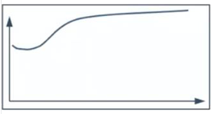
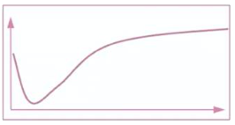
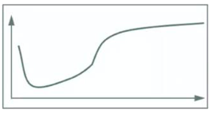
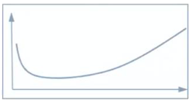
Recovery
1 New or substitute offerings (e.g. Digital)
2 The first forays into safe travel
3 Redesign required
4 The longer road ahead
Recovery
Outlook
Segments
Digital experiences
Digital event platforms
Digital gaming
Travel insurance
Long term vacation rentals
Trains
Destination family vacation rentals
Leisure-focused hotels
Car rentals for leisure
Intermediaries
River cruises
Theme parks
Airports
Casinos
Business focused hotels
F&B travel
Shot-haul/ domestic air travel/car rental
Cruises
Long-haul air travel
Tour operators
Experiences/ activities
Airport hotels
Spas
Travel management companies/ convention hotels
Bain & Company, 2020

Slide 5
Recruitment
Quiet March to June
Pick up July to Sept
Holding pattern until 2021

Slide 6
Retention
13% of UK workforce NOT open to opportunities
Post-redundancy workforce – the best people
How are you keeping people happy?

Slide 7
Employment Trends & Challenges
Working hours changed
  48 mins more each day
12% more time spent in meetings (Bloomberg)
  Zoom fatigue
Less face to face time
  Training, slower information transfer
Productivity
  More or Less?

Slide 8
Recruitment Trends & Challenges
It’s quiet
Employers recruiting directly
  Time to deal with 300+ responses
  Speaking to a 15 person longlist
  Risk of employer reputation damage
Confidential positions
Salaries staying constant

Slide 9
What employees want
Flexibility – different for everyone
Different leadership
Understanding the recovery plan
Different benefits
Safe conditions

Slide 10
The Future
  Employee engagement
    Have you developed your benefits and wfh policies?
  Training and Development
  Employee attraction
  Growth of interims

Slide 11
Q&A

