Slide 1
Tales from either side of the fence
what pricing is really like in retailers like yours. Ian Ayling has worked with and for some of the UK’s most famous retailers and CPGs. He has a view of how price and promo really ought to work and has experience of where things fall short. He’ll share tales of glory and war stories alike with the aim of a group conversation of how to price better.

Slide 2
Session objectives
How to price better
Themes for stimulus from my work life
Group discussion

Slide 3
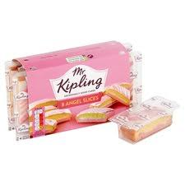
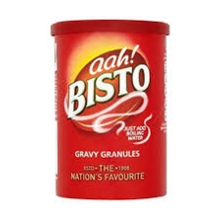
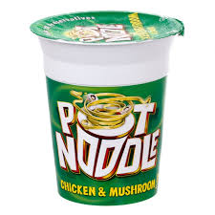
My work history

Slide 4
£1
Notes:
What is the context for this decision?

Slide 5
Objective = Value for money?
Government definition
The most advantageous combination of cost, quality and sustainability to meet customer requirements. ... quality means meeting a specification which is fit for purpose and sufficient to meet the customer's requirements.

Slide 6
Are we good value for money? A complex formula however you define it
Three types of measures?
Perception – “I rate them as good value for money”
Behaviour – “Customer value is growing as expected”
Operational – “we are within 1% of Tesco”
Three types of motivators?
My beliefs
Our offer
What?
Why?
Value
The experience
How?

Slide 7
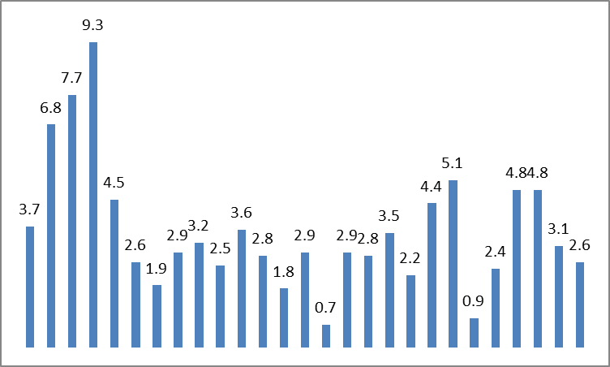
Substitutability – what will meet the customer’s requirement
My career started in high inflation era
How to inflate!
Competition laws flattened inflation and created a focus on cost
Supplier relationships
Discounters
Own brand
New questions being raised about cost with sustainability
New taxes
Living wage
→ What next?
UK RPI 1987 to 2013
‘87 – ’91
Hi inflation
‘01 & ‘08
Lo inflation

Slide 8
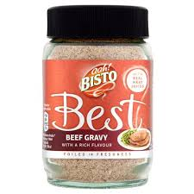
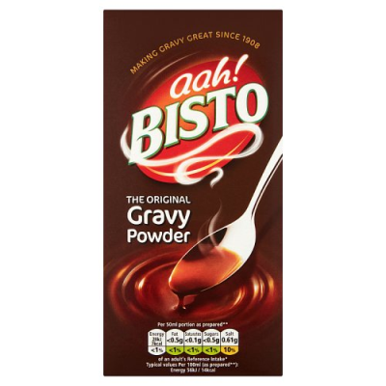
Bisto product range elasticity
Price ££
Margin £
( )
1.4
Price £
Margin ££
0.9
1.2
1.8
Price £
Margin £££
0
Other flavours appear incremental

Slide 9
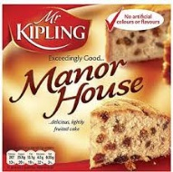
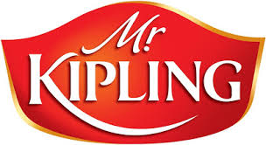
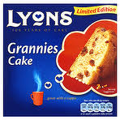
Manor Bakeries (RHM)
Product loyalty +
Brand defendability
= right to price independently

Slide 10
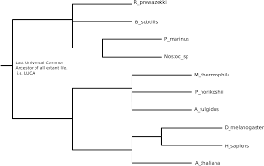
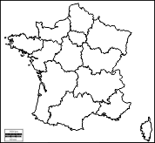
Grocery ranging
Historically ranging based on item profitability, sales, supplier ORD, innovation
Tools and insight introduced to incorporate substitutability and best customer behaviour
Challenges good;better;best decisions (entry price range)
Challenges range delists (leg of lamb)
Challenges store distribution decisions (Monoprix)
Range design is the best driver of value perception

Slide 11
Customer journey – how customers find their requirements
Role of price varies by context
Grocery item | Convenience item | DIY item | Digital service
Past behaviour Publicity Recipe Retailer search (Trip) | Past behaviour Publicity Need in moment Location search | Family Online search – need driven Retailer search (Item) | Family Online search – provider driven
Feature in store Autopilot | Feature in store Edited selection | Staff enquiry Risk management | Qualification process Digital path
Routine Word of mouth | Need fulfilled Word of mouth | Project plan Social sharing of success | Passive until needed Issues socialised
Research
Fulfillment
Use and advocacy

Slide 12
Change story
From
Prices high, % on promotion high
High volume of comparable items with future demand risk – crisps, sweets, drinks, lottery, cigarettes, news
Vulnerable to convenience competitors
To
Prices acceptable, promotion better targeted
Grow meal solutions, grow non comparable products
Defendable against convenience competitors

Slide 13
Revised category decision making
Convenience premium
Category logic
Category competition
Category importance
Ability to compete (Input cost / margin)
All beautiful plans have exceptions

Slide 14
Online delivery charge
There is a real cost
No one wants to pay it
Online margins suffer as a result
Omni-channel does create higher value, especially click and collect
Customer centric decision takes account of this
Are costs better bundled or split out?

Slide 15
Purpose – why the business makes the decisions it does and customers buy into them
Examples of Purpose / vision statements
To free up hard working families to be the best they can be
Good food costs less at Sainsburys
Championing a better way to do business for you and your communities
Nourishing a world of diversity
Saving people money so they can live better
Earth’s most customer-centric company

Slide 16
Free up hard working families to be the best they can be
>20k products that simply help from >40 sub categories
JK Wilkinson set the business up in 1930
= counter service not self service
“I cannot look a customer in the eye and know I have not given them good value”
“Customers want to buy when they are ready to buy”
= lowest possible price & price stability
= margin cap & limited promotion count

Slide 17
Value of price stability
Case for stability
Customers shop when they are ready to shop
Wilko customers have limited cash flow and plan for what they need
“I want to know that you can sort my need today”
Customer trust grows with stability
Case for reaction
Many competitors, many promotions, am I cheapest today?
Buying team culture – I have to change something to compete
Corporate direction – we need to raise / invest £xxm
We need to test and learn
Product price optimisation grows with reaction

Slide 18
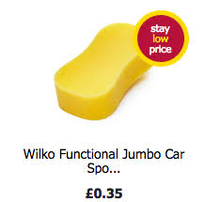
Communicating price
Stay low price
Launched as a product initiative
Understood to be a brand proposition
Simply help
Round pound, 0’s & 5’s, promo mechanics
Colour strategy – what can actually be seen?
All channels support each other – 1 national price
Reinforce customer experience
Tempting to believe promo drives trade
More evidence that the item that works for me and really cost 35p is what brings me back

Slide 19
Maybe this is the full picture?
Demand definition
Customer-led business interventions
Customer diversity / conformity
Brand purpose
Demand activation
Life needs
Product sectors
Jobs to be done
Customer journey
Customer pricing
Why?
What?
How?
Business strategy
Operating model
Business Engagement
Change leadership
Planning cycle
Performance enablement

Slide 20
So…how to price better?
What would we propose are the golden rules?

Slide 21
Thank you
Ian Ayling @ The Marketing Shed - “Future proofing organisations”
Email: ianayling@aol.com
Mobile: +44 7730 647162
Linkedin: linkedin.com/in/iayling

