Slide 1
Increasing Pricing Capability
Marion Veber
Christos Roussakis
RMAPI Conference 09/03/2023

Slide 2
1
Context and Objectives

Slide 3



We were relying in a fare structure that was in place for way too long and was not addressing the challenges of the post pandemic era
2020
2021
2022
2023
Inventory System
Resarail
S3 Passenger
Relatively stable demand
Any disruption was somewhat contained and even mitigated
Demand collapsed due to the covid pandemic
Government regulations effectively made international travel prohibitive
Uncertainty severely disrupted booking behaviour
Faster than expected recovery
Inflation affecting customers’ purchasing power
Market Conditions
Old, cumbersome inventory system
18 month freeze due to “Horizon” programme
Survival & Recovery
Frequent timetable adjustments
Resource constraints
Employee turnover
Customer perceptions in a post covid era
Increased costs
Capacity constraints
Business Challenges
During covid, it allowed us to tackle the operational challenges
S3 Passenger is a game changer!
Post covid, it opened an entire new set of capabilities that helps us deliver on our commercial objectives

Slide 4




This project had to reconcile some opposing themes
Achieve our 2023 objectives
Provide RM with greater flexibility
Maintain our VFM score
Remain competitive
As we emerge from the pandemic, we’ve set ourselves some very ambitious targets, especially in terms of yield.
RM had identified the need of greater flexibility to maximize revenue not only at peak but also at off-peak times
Any intervention had to take into consideration our customers’ willingness to pay
We pay close attention to the wider industry and we would like to maintain our market position

Slide 5
2
Our approach

Slide 6


The project was broken down in 4 main steps
Discovery
Analysis
Development
Testing
Research customer behaviour and willingness to pay
Review research results and model alternatives
Input changes into he inventory
Adapt RM tools to accommodate changes
End to end testing to ensure all systems respond as expected
Go live

Slide 7
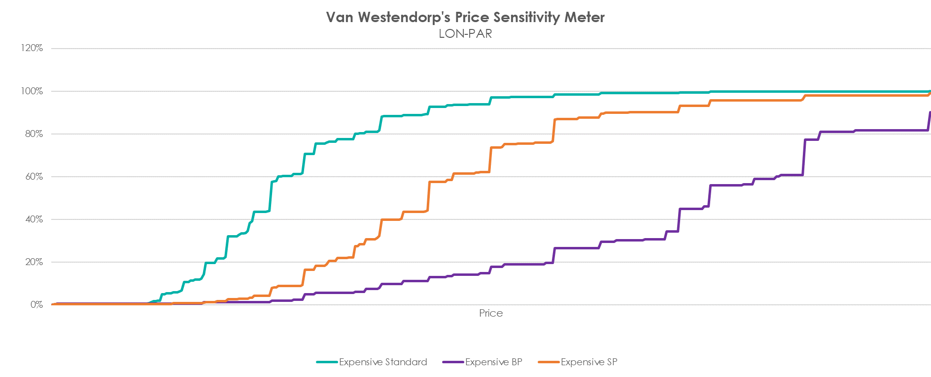
We used the Van Westendorp Price Sensitivity Meter to measure our customers’ willingness to pay…
source: Simon-Kucher x Eurostar – NCO – EIL pricing analysis

Slide 8
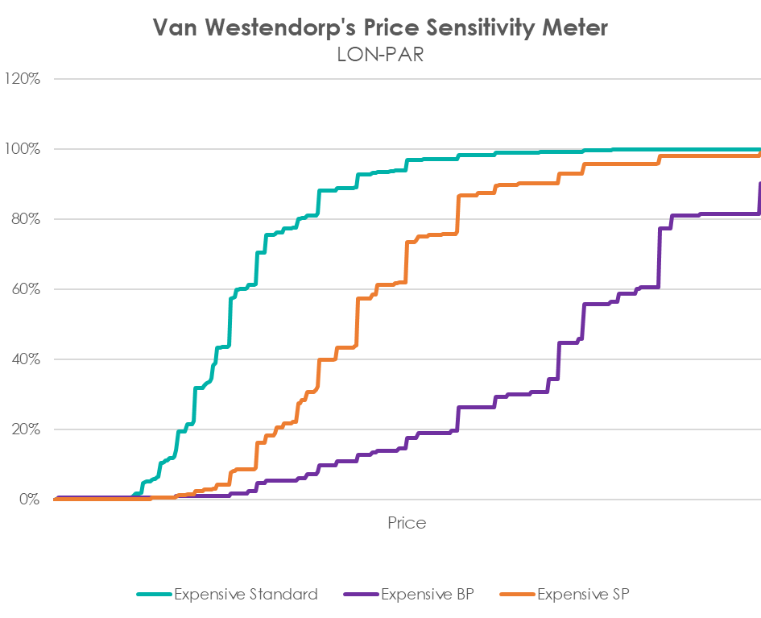
We used the Van Westendorp Price Sensitivity Meter to measure our customers’ willingness to pay…
…and we came across some interesting findings:
1 |  | There are multiple points where customer perception changes significantly
source: Simon-Kucher x Eurostar – NCO – EIL pricing analysis

Slide 9
We used the Van Westendorp Price Sensitivity Meter to measure our customers’ willingness to pay…
…and we came across some interesting findings:
1 |  | There are multiple points where customer perception changes significantly
2 |  | These points are closer together when the prices are low and get further apart as prices go up
source: Simon-Kucher x Eurostar – NCO – EIL pricing analysis

Slide 10
We used the Van Westendorp Price Sensitivity Meter to measure our customers’ willingness to pay…
…and we came across some interesting findings:
1 |  | There are multiple points where customer perception changes significantly
2 |  | These points are closer together when the prices are low and get further apart as prices go up
3 |  | There are more such points in our Standard class and less at the higher classes. Also, the curve becomes less steep at the higher classes
source: Simon-Kucher x Eurostar – NCO – EIL pricing analysis

Slide 11





The insights we gathered resulted in 3 key changes:
Increase the number of buckets
Almost 2.5K more price points were created, allowing for better pricing segmentation and more opportunities to maximize revenue
Decrease the gaps between buckets
Having more price points allows us to have smaller gaps between buckets, giving RM more flexibility to price up but also down depending on performance
Align price points with the price sensitivity insights
We closely followed the insights from the Van Westendorp model to determine he optimal price points by class of travel

Slide 12



The project was delivered in time and within budget thanks to the close collaboration across teams, a well defined task distribution and rigorous testing
Define number of buckets
Confirm new price points
Pricing
Testing checklists
Load & update price points in the inventory
Inventory Data Loading
Update RM tools to include new buckets
Raise awareness for potential system problems and propose solutions
Information Systems
Weekly progress meetings
Refresh strategies per train with the new buckets
Ensure optimiser accuracy
Revenue Management

Slide 13
3
Results

Slide 14




We’ve put in place an extensive plan for measuring the impact combining multiple data sources
We’ve already built several reports, monitoring multiple KPIs such as average yield, booking horizon, etc.
We perform surveys in regular intervals and the questionnaire is constructed in a way that allows us to spot any changes in trends
The nature of the change requires monitoring over the course of several months in order to reach a definitive assessment of the value created by this project, however initial results are very promising.
Transactional data
Surveys
We also monitor customer behaviour on our online channels and are particularly interested in conversion rate by price point and differences across markets etc.
We aim to conduct interviews with key clients and distributors to understand how our new fare structure has performed from their perspective
Web analytics
Interviews

